Slide 1
Blockchain Final Project Quartet Ron Friedman 209490358 Netanel Konforty 312463425

Slide 2
Introduction
Quartet Game is a popular game in Israel.
Sometimes people cheat while playing this game.
Therefore we came up with the idea to build a playing system based on blockchain and verification with merkle tree

Slide 3

Technologies
Visual Studio Code
Remix
MetaMask
Soldiity
Html
CSS
JavaScript
Cmd Shell
Truffle
Ganache

Slide 4
Quartet Card Game

Slide 5
4 Players
40 Cards, separated to 10 categories, 4 cards each.
The winner is the player with the biggest number of sets of 4 cards from the same family.
Each player, in his turn, can ask one other player for a card from one of the categories he has.

Slide 6
You can buy some extraordinary utilities using the winning prizes:
Joker – Can be any card
Swapper – Swap your cards with other player
Watcher – Watch other player’s cards

Slide 7

Parts

Slide 8

Contracts
Quartet.sol
Card.sol
QuartetCoin.sol

Slide 9
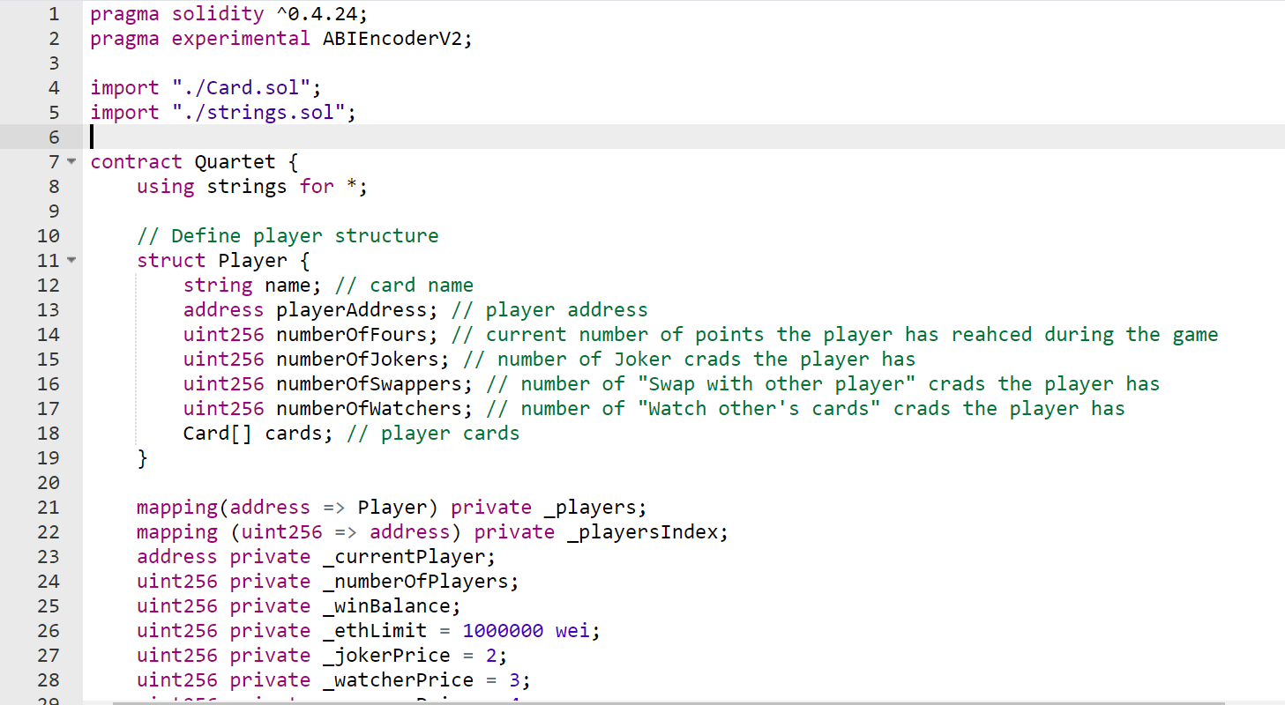
Quartet.sol is the main contract – the main that is being called according to user choices in the game.

Slide 10
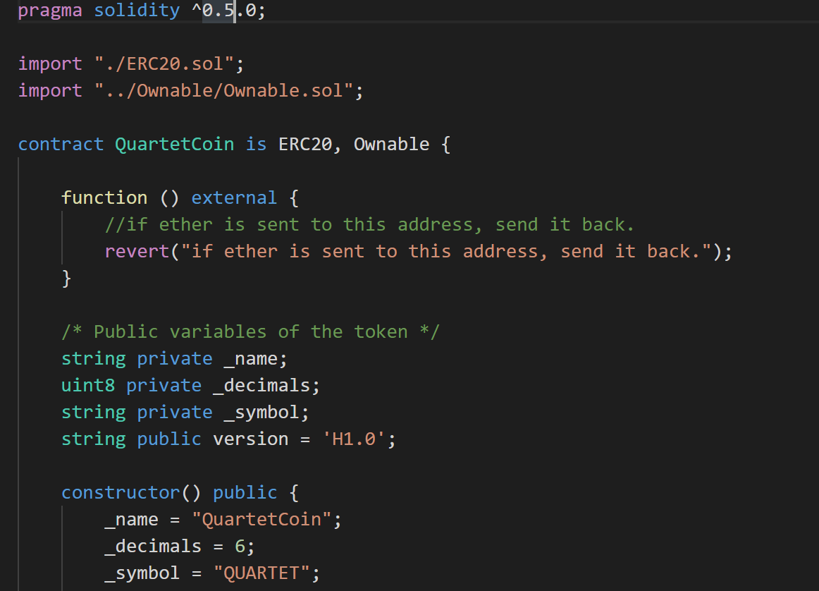
QuartetCoin.sol is a contract that represents our ERC20 token that is used for buying stuff and as winning prize.

Slide 11
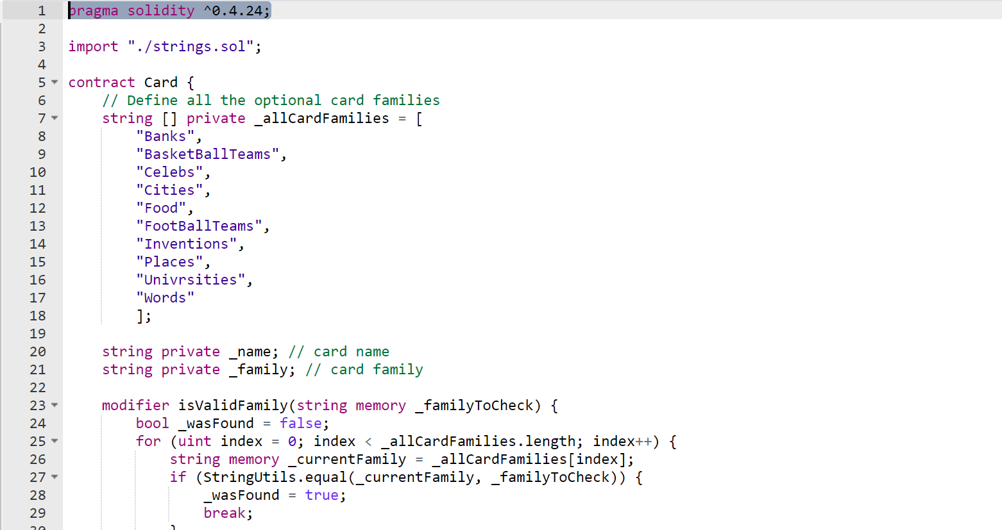
Card.sol is a contract that represents the basic element in the game – a card, a card that has name and family. In addition, every card has hash.

Slide 12

GUI
Html
JavaScript
Css
Web3JS

Slide 13

How to Run & Play ?

Slide 14
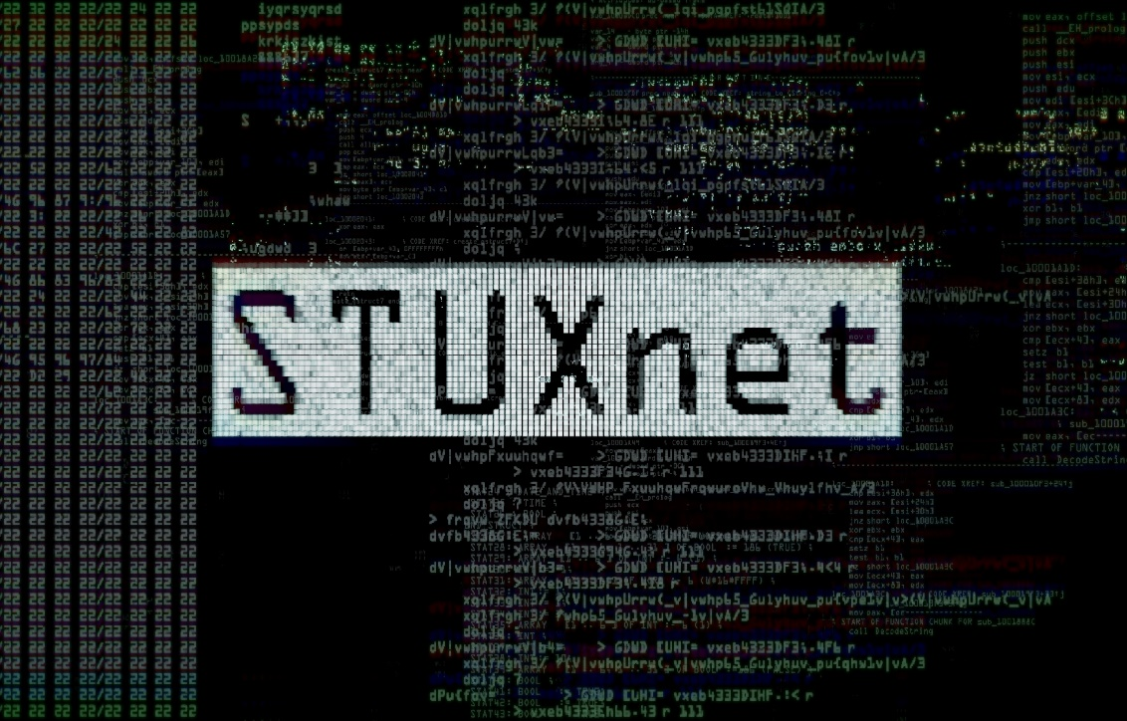
Place your screenshot here

Slide 15
Place your screenshot here

Slide 16
Place your screenshot here

Slide 17
Any Questions ?

Slide 18

Dare To Dream

